Slide 1
Diyala university
College of engineering
Department of computer engineering
Second stage
8086 Microprocessor
Assistant lecturer: Abdullah Thaier Abdalsatir

Slide 2
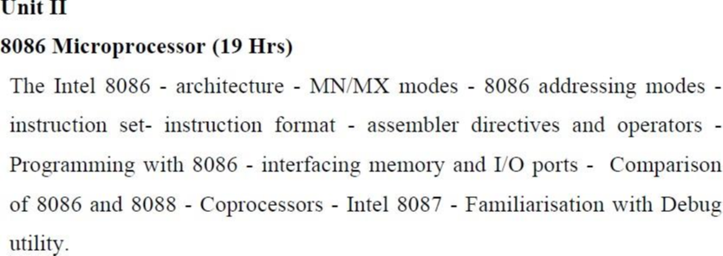
Microprocessor
Program controlled semiconductor device (IC) which fetches (from
memory), decodes and executes instructions.
It is used as CPU (Central Processing Unit) in computers.
2

Slide 3
Fifth Generation
Pentium
Fourth Generation
During 1980s
Low power version of HMOS technology
(HCMOS)
32 bit processors
First Generation
Between 1971 – 1973
PMOS technology, non compatible with TTL
4 bit processors  16 pins
8 and 16 bit processors  40 pins
Due to limitations of pins, signals are
multiplexed
Physical memory space 2
24
bytes = 16 Mb
Virtual memory space 2 bytes = 1 Tb
Floating point hardware
Supports increased number of addressing
modes
40
Intel 80386
Second Generation
During 1973
NMOS technology  Faster speed, Higher
density, Compatible with TTL
4 / 8/ 16 bit processors  40 pins
Ability to address large memory spaces
and I/O ports
Greater number of levels of subroutine
nesting
Better interrupt handling capabilities
Third Generation
During 1978
HMOS technology  Faster speed, Higher
packing density
16 bit processors  40/ 48/ 64 pins
Easier to program
Dynamically relatable programs
Processor has multiply/ divide arithmetic
hardware
More powerful interrupt handling
capabilities
Flexible I/O port addressing
Intel 8085 (8 bit processor)
Intel 8086 (16 bit processor)
3

Slide 4
Functional blocks
Unit;
performs arithmetic and
logic operations
Computational
Various conditions of the
results are stored as
status bits called flags in
flag register
Internal storage of data
Register array or
internal memory
Data Bus
ALU
Instruction
decoding unit
Generates
the
address
the
instructions to be
fetched from the
of
Flag Register
ry and send
through address
to
memo
Timing and
control unit
bus
memory
the
PC/ IP
Control Bus
Address
Bus
Generationer
l signals for
Decodes
sends
information to the timing and
control unit
internal
and
external
instructions;
operations
of
the
4
microproces
sor
s

Slide 5
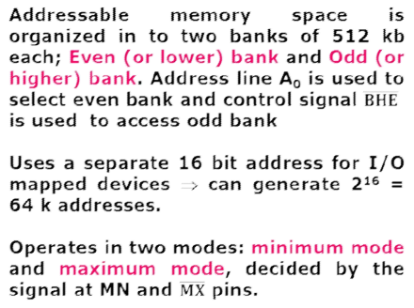
Overview
❖First
16
-
bit processor
released by
INTEL in the year 1978.
❖Original
ly HMOS, now manufactured
using HMOS III technique.
❖Approximately 29,
pin DIP, 5V supply.
000 transistors,
40
❖Does not
have internal clock;
external
asymmetric clock source with 33% duty
cycle.
❖20
-
bit address to access
memory
⇒
= 1 megabytes of
can address up to 2
memory space.
20
❖ Contains
About 29000
Transistors.
5

Slide 6
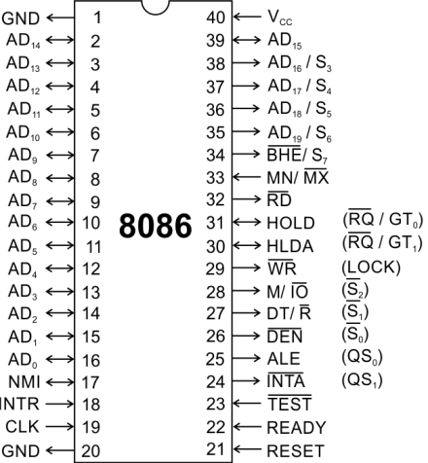
Pins and Signals
Common signals
AD -AD
(Bidirectional)
0
15
Address/Data bus
Low
order
bus;
these
are
address
multiplexed with data.
When AD lines are used to transmit
memory address the symbol A is used
instead of AD, for example A0-A15.
When data are transmitted over AD lines
the symbol D is used in place of AD, for
example D0-D7, D8-D15 or D0-D15.
A /S , A /S , A /S , A /S
16
3
17
4
18
5
19
6
High order address bus. These
multiplexed with status signals
are
6

Slide 7
8086
Microprocessor
Pins and Signals
Common signals
BHE (Active Low)/S (Output)
7
Bus High Enable/Status
It is used to enable data onto the most
significant half of data bus, D8-D15. 8-bit
device connected to upper half of the data
bus use BHE (Active Low) signal. It is
multiplexed with status signal S7.
MN/ MX
MINIMUM / MAXIMUM
This pin signal indicates what mode the
processor is to operate in.
RD (Read) (Active Low)
The signal is used for read operation.
It is an output
signal. It is active
when low.
7

Slide 8
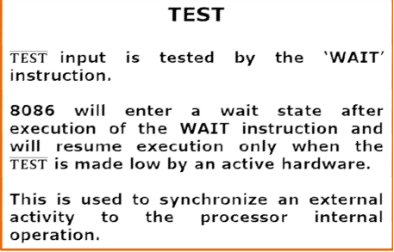
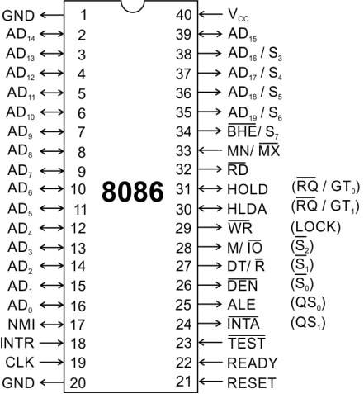
8086
Microprocessor
Pins and Signals
Common signals
READY
This is the acknowledgement from the
slow device or memory that they have
completed the data transfer.
The signal made available by the devices
is
synchronized
by
the
8284A
clock
generator to provide ready input to the
8086.
The signal is active high.
8

Slide 9
8086
Microprocessor
Pins and Signals
Common signals
RESET (Input)
Causes the processor to immediately
terminate its present activity.
The signal must be active HIGH for at
least four clock cycles.
CLK
The clock input provides the basic timing
for processor operation and bus control
activity. Its an asymmetric square wave
with 33% duty cycle.
INTR Interrupt Request
This is a triggered input. This is sampled
during the last clock cycles of each
instruction to determine the availability of
the request. If any interrupt request is
pending,
the
processor
the
enters
interrupt acknowledge cycle.
This signal is active high and internally
synchronized.
9

Slide 10
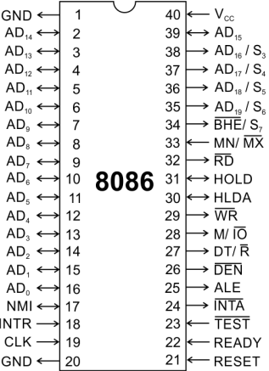
8086
Microprocessor
Pins and Signals
Min/ Max
Pins
The 8086 microprocessor can work in two
modes of operations : Minimum mode and
Maximum mode.
In the minimum mode of operation the 8086
Microprocessor do not associate with any
co-processors and can not be used for
multiprocessor systems.
In the maximum mode the 8086 can work in
multi-processor
configuration.
or
co-processor
Minimum or maximum mode operations are
decided by the pin MN/ MX(Active low).
When this pin is high 8086 operates in
minimum mode otherwise it operates in
Maximum mode.
10

